Slide 1
Java Collections Framework
Hierarchy
Ordered vs Non-Ordered Collections
Set vs List
HashCode, Equals, Immutability, and Custom Objects as Keys
Internal Working of HashMap and HashSet
ArrayList vs LinkedList
HashMap vs LinkedHashMap

Slide 2
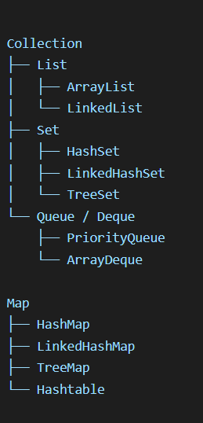
Java Collections Hierarchy
Top-Level Interfaces
Collection
Root interface for most collection types
Map
Separate hierarchy, stores key-value pairs
Under Collection
List
Ordered, allows duplicates
Set
No duplicates
Queue / Deque
Used for FIFO / double-ended operations
Under Map
HashMap
LinkedHashMap
TreeMap
Hashtable

Slide 3
Ordered vs Non-Ordered Collections
Ordered Collections
Maintain a predictable order of elements
Order can be:
insertion order
sorted order
access order
Examples
List: insertion order preserved
LinkedHashSet: insertion order preserved
LinkedHashMap: insertion order or access order preserved
TreeSet / TreeMap: sorted order
Non-Ordered Collections
No guaranteed iteration order
Examples:
HashSet
HashMap
Important note
“Ordered” does not always mean “sorted”
It may mean insertion order

Slide 4
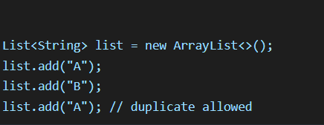
List
Key Properties
Ordered collection
Allows duplicates
Index-based access
Multiple null values allowed in ArrayList
Good when:
order matters
frequent access by index is needed
Common implementations
ArrayList
LinkedList
Vector
Stack

Slide 5
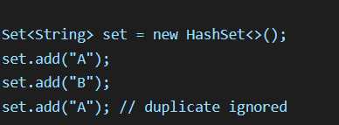
Set
Key Properties
No duplicate elements
Usually no index-based access
Best when uniqueness is important
Common implementations
HashSet → no order
LinkedHashSet → insertion order
TreeSet → sorted order

Slide 6
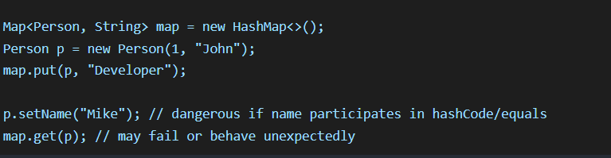
HashCode, Equals, Immutability, Custom Object as Key
Why equals() and hashCode() matter
In HashMap, HashSet, and similar hash-based collections:
hashCode() decides the bucket
equals() decides exact match within the bucket
Contract
If two objects are equal using equals(), they must have the same hashCode().
Why immutability matters for keys
A key should not change after insertion into a hash-based collection. If fields used in hashCode() or equals() change:
object may become “lost” in the map/set
retrieval/removal may fail
Best practice
Use immutable fields for keys
Override both equals() and hashCode()
Prefer making key classes immutable

Slide 7
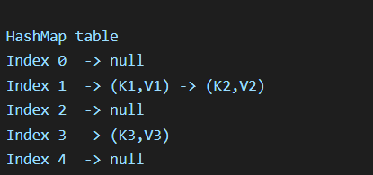
Internal Implementation of HashMap
Basic idea
HashMap stores data in an array of buckets.
How it works
Compute hashCode() of the key
Convert hash to bucket index
Store entry in that bucket
If collision occurs, use:
linked list in older versions
tree structure in Java 8+ when collisions are large
Collision handling
When two keys map to the same bucket:
compare using equals()
if same, replace value
if different, store as another node in the same bucket
Java 8 enhancement
If a bucket becomes too large, it can convert into a balanced tree for faster lookup

Slide 8


Internal Implementation of HashSet
HashSet is backed by HashMap
HashSet internally uses a HashMap
Elements are stored as keys
A dummy constant value is used
Visual
Why HashSet has no duplicates
Because keys in a map must be unique
Internal logic

Slide 9

ArrayList vs LinkedList
ArrayList:
Backed by dynamic array
Fast random access by index
Slow insert/delete in middle due
to shifting
Better for read-heavy use cases
LinkedList:
Backed by doubly linked list
Fast insert/delete if node reference is known
Slow random access because traversal is required
Better for frequent insertions/removals

Slide 10
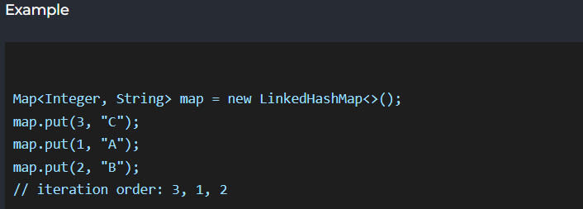
HashMap vs LinkedHashMap
HashMap
No ordering guarantee
Fast lookup
Best for performance-focused key-value use
LinkedHashMap
Maintains insertion order
Can maintain access order
Slightly more memory overhead
Use cases
HashMap: caching, lookup
LinkedHashMap: ordered iteration, LRU cache

Slide 11
Summary
Use List when:
duplicates are allowed
order matters
index-based access is important
Use Set when:
uniqueness matters
duplicates should be removed
Use HashMap when:
you need fast key-value lookup
ordering is not important
Use LinkedHashMap when:
insertion order matters
predictable iteration is required
Use immutable custom keys when:
you store objects in HashMap / HashSet

